Slide 1


Illinois
Prescription Monitoring Program
November 14, 2017
Sarah Pointer, Pharm D.
Clinical Director of the Illinois Prescription Monitoring Program

Slide 2
Agenda
Provide an overview of the Illinois Prescription Monitoring Program (IL-PMP)
Update on IL-PMP initiatives
Define PMP Goals
Update on New Legislation
Notes:
Today I plan to provide you all with a brief over view of the program, update you on some of our current initiatives, touch very briefly on the law enforcement request process, and provide you with an update on some current legislation that may directly impact physicians.

Slide 3
Illinois Prescription Monitoring Program Overview
The ILPMP receives Controlled Substance prescription data from retail pharmacies on an end of next business day basis and allows Prescribers and Dispensers to view the historical data for current and prospective patients.
Notes:
The Illinois Prescription Monitoring Program was authorized by the Illinois controlled substance act as state-run electronic database used to track the prescribing and dispensing of controlled substance prescription drugs to patients.
Pharmacies report controlled substance prescription information to the PMP on a daily basis to help monitor for suspected abuse or diversion and this information provides a prescribers and dispensers information regarding a patient’s controlled substance prescription history. This information can help prescribers and dispensers evaluate patients and possibly identify patients at high-risk who would benefit from early interventions.
For proper utilization we know that we will need additional tools to increase awareness and education about the program.
The CDC considers PMP’s one of the most promising state-level interventions to improve opioid prescribing. And the CDC also recognizes Illinois as one of the premier PMP’s and they want to use Illinois as a model for the implementation of other state PMP’s.

Slide 4

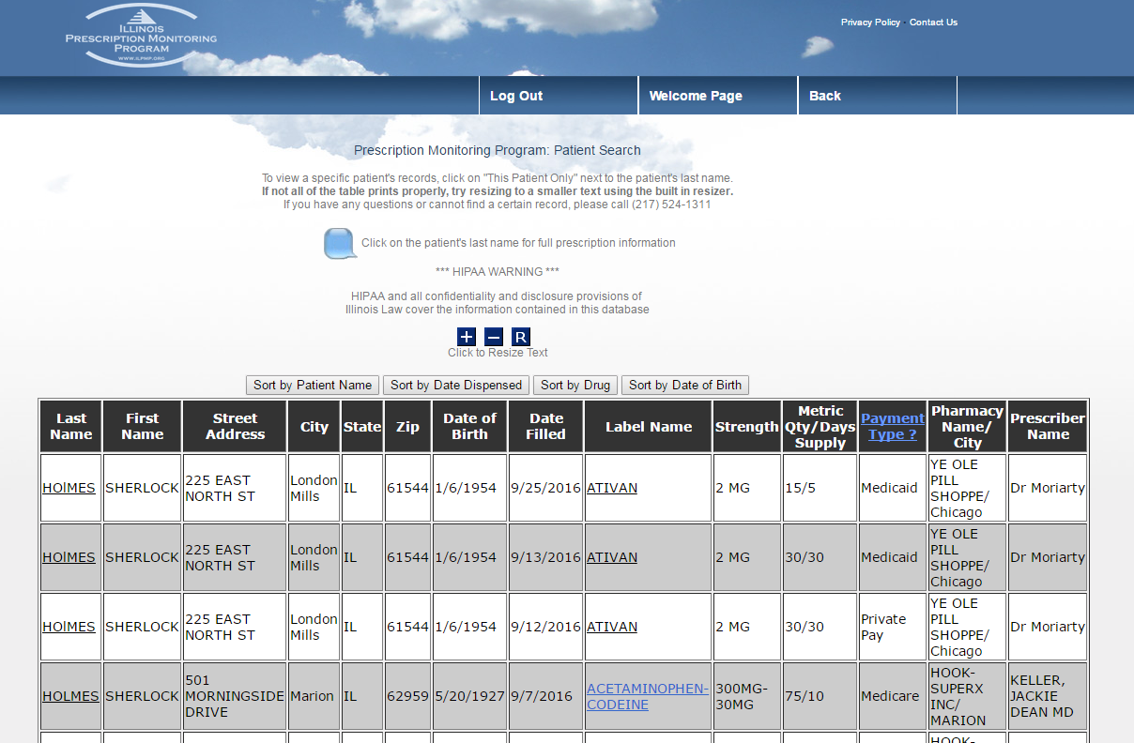
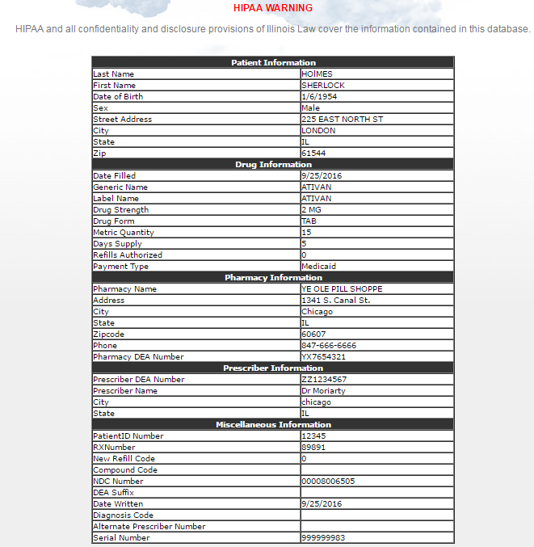
Notes:
The PMP website allows Prescribers and Dispensers the ability to view a rolling 12 month view of a patients controlled substance history. Utilizing the patients first name, last name, and date of birth, users can view Drug information, Pharmacy Information, method of payment, as well as the Prescriber information. Additionally, a prescriber can click on the My Prescriptions link to view prescriptions that have been attributed to their DEA#. This can greatly assist users if they suspect that drug diversion is happening.

Slide 5
PMP Initiatives:
Identify High Risk Behaviors
  Intervention focus
Implement opioid prescribing intervention guidelines
Implement Designee Utilization Capabilities
Integrate Hospital and Pharmacy EHR systems via the PMP Automated Connection
Notes:
In 2013, the PMP received a grant from the Centers of Disease Control to focus on certain initiatives to curb the prescription drug abuse epidemic. These strategies are as follow. The idea is to come up with a multi-pronged approach to inform the doctor of proper prescribing guidelines, identify patient, prescriber, and dispenser characteristics that could be viewed as “high risk” so that we know where to focus our intervention efforts.
Finally make the PMP easier for Prescribers and dispensers to utilize in their workflow by incorporating into EHR systems across the state.

Slide 6
ILPMP Advisory Committee
There is created a PMP Advisory Committee to assist the Department of Human Services in implementing the PMP created by this Article and to advise the Department on the professional performance of prescribers and dispensers, as well as other matters that are germane to the advisory committee’s field of competence.
Notes:
2015 Controlled substance Act section 320
The advisory committee shall be composed of prescribers and dispensers as follows:
4 physicians
3 pharmacists
1 dentist
1 podiatric physician
1 optometrist
1 advance practice nurse
1 physician’s assistant

Slide 7
PMP Peer Review Subcommittee
Quarterly review data relative to identifying prescribers or dispensers practicing outside of currently accepted standards in the course of their practice.
  Risk score equation based on total Morphine Milligram Equivalents (MME), total opioid patients, concomitant Benzodiazepine Equivalents, and co-prescribing of a hypnotic
Suggest communications to be sent via email to all registered prescribers or dispensers.
Notes:
5 members of the PMP Advisory Committee (3 physicians and 2 pharmacists) to serve as member of the peer review subcommittee.
Discussions concerning how to construct an initial correspondence to prescribers from the Peer Review Committee without inflicting the law of unintended outcomes.

Slide 8
Unsolicited Prescriber Letters
Identifying high risk prescribers for notification and possible academic detailing
Notify prescribers prescribing higher rates of MME compared to their peers
Notify prescribers of high risk patient activity
Notify prescribers of fatal and non-fatal patient overdoses
Notes:
Currently, the Peer-Review Committee has been undertaking the development of reports from just the dispensing information.
The Peer-Review subcommittee has been establishing the process and criteria for review
While this gives some information, a substantial portion of the clinical picture is missing for one to make a clear determination of adherence to given guidelines or algorithms. Currently the Peer-Review is building its base data from which individualized unsolicited reports will be generated.
As these practitioners are being reviewed, their prescribing will be evaluated against the top 250 patients seeing multiple prescribers and/or who have been at high MME/day doses along with other central nervous system depressants.

Slide 9
PMP Goal:
  Develop training and education and materials for:
    Prescribers
    Dispensers
    Patients
  Enlist local health department personnel to bring awareness to the PMP and disseminate regional statistics
  Focus on “High Burden Areas” including:
    Delta Region 16 counties in lower Illinois
    Cook County
Notes:
With these initiatives, goals were put into place. The idea was that while the initiatives are helpful with strategies, what are we going to do with the information. So, the PMP came up with goals to help follow-through. For example: Once we have identified high risk patients and areas, what are we going to do with the data? The PMP will utilize local health departments to aid in information dissemination to prescribers, dispensers and patients in their areas.

Slide 10
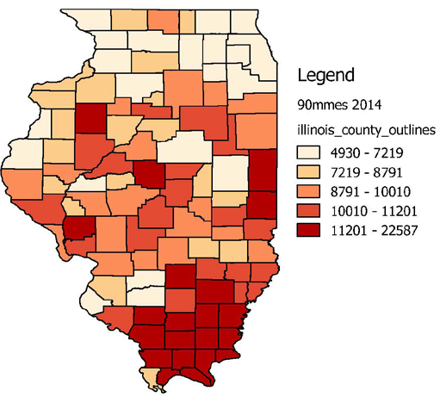
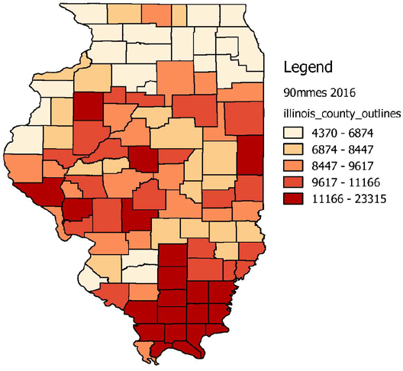
Number of patients (per 100,000) receiving more than a 90 Milligram of Morphine equivalent dose of Opioids per day
Notes:
By identifying high risk area, or “Hot Spots” , we can better focus our prevention efforts

Slide 11
PMP Goal:
  Increase access by medical providers
  Public Act 99-480 “Heroin Crisis Act”
  Designee Capabilities
    Authorized Designees
1) registered nurse
2) licensed practical nurse
3) pharmacy technician
4) student pharmacist
5) certified medical assistant
Notes:
With these initiatives, goals were put into place. The idea was that while the initiatives are helpful with strategies, what are we going to do with the information. So, the PMP came up with goals to help follow-through. For example: Once we have identified high risk patients and areas, what are we going to do with the data? The PMP will utilize local health departments to aid in information dissemination to prescribers, dispensers and patients in their areas.
There will be additional housekeeping involved but the time it saves in daily work flow will far outweigh the amt of time to keep the designee list up to date.

Slide 12
Designee Capabilities
  The prescriber or dispenser shall only have up to three designees.
  The prescriber and dispenser shall register the designees and must also agree to the terms and conditions for designees.
  Each designee shall have an individual account that must be linked to the prescriber or dispenser
Notes:
Public Act 99-480 “Heroin Crisis Act”
Designees authorized to utilize PMP
h) PMP shall send out a notice for the prescriber or dispenser to ensure continued employment of their designees. If the
designee is no longer employed with the prescriber or dispenser, the prescriber or dispenser shall terminate the designee's
access to the PMP by locking the designee's account or by notifying the PMP that the designee's account should be locked.
Will having an authorized designee help reduce that time?
Yes, the prescriber will not have to login, but still should be the one interpreting the results. Please note, more housekeeping will need to be done by the prescriber such as once a quarter he/she will need to login, and view their designee’s searches and recertify/remove their designee’s access.

Slide 13
PMP Goal:
  Increase ease of use
  Makes PMP more accessible to prescribers
  Ability to integrate with any EHR system
  AUTOMATED CONNECTION
Notes:
Started in 2013 to expedite the login process for PMP users
The original access method was the website, where a user would log in with their own unique username and password, enter a patient’s first name, last name and date of birth to retrieve their patient’s controlled substance profile. The Automated Connection grew out of the necessity to make this process more end-user friendly.
Initial conversations about the Automated Connection project started in 2013 through collaboration with the PMP, Anderson Hospital, and Logicoy, a systems integrator, to expedite the login process for PMP users. The goal was to make the PMP more accessible to Prescribers by allowing a Health Care Organization's EHR system the ability to directly query the PMP database. This offers many benefits as the prescriber does not have leave their current work flow to pull a website, recall their username/password, etc.

Slide 14




PMP Website
Medication Review Flow:
User logs in twice to PMP & EHR for a clear picture of medication use
EHR
Before Integration
PMP
Notes:
Website utilization
PMP User logs on to website
Average of two minutes from log on to search result
View results on PMP website

Slide 15

Automated Connection
EHR-PMP Pathway:
EHR
User logs into EHR and navigates to a tab to view PMP data
After Integration
PMP Data
PMP
Notes:
Automated Connection Utilization
User opens HER
PMP results in 1-2 seconds
View results on pdf inside HER
Integration into E.D., ambulatory services and EMT’s

Slide 16
PMP Automated Connection
  Currently 19 Health Care Organizations have integrated the Automated Connection
    Each HCO maintains multiple sites
  Increase in the number of checks to the PMP
    June 2016- we had 224,670 checks to the PMP
    June 2017- we had 899,991 checks to the PMP

Slide 17
Utilization: Queries
899,991
Lawndale
Blessings
Rush
Anderson
Northwestern
Dreyer Clinic
Springfield Clinic
Pain Centers of Iowa
Rockford Health System
Lake County Health Dept.
June Queries YoY
2014: 5,135
2015: 5,077
2016: 224,270
2017: 899,991
Access Community Health Network
Carle Foundation
224,270
Southern Illinois Healthcare
5,135
5,077
*The number of requests via automated connections. These requests can be made be made by an EHR system before a prescriber has seen the patient.

Slide 18
Automated Connections
The PMP has an automated connection with 13 healthcare provider systems, with a total of 322 sites. EHR systems include Epic, Cerner, Meditech, AllScripts, NextGen, and GE Centricity.
Provider | Live Date | # Sites
Anderson Hospital | 4/10/2014 | 5
Northwestern Medicine | 6/15/2015 | 15
Springfield Clinic | 7/6/2015 | 102
Pain Centers of Iowa | 3/4/2016 | 6
Dreyer Clinic (Advocate Dryer) | 5/17/2016 | 13
Rockford Health System | 6/11/2016 | 12
Lawndale | 7/20/2016 | 6
Blessings | 10/17/2016 | 8
Access Community Health Network | 11/18/2016 | 36
Lake County Health Department | 1/12/2017 | 13
Rush University Medical Center | 2/1/2017 | 80
Carle Foundation Hospital | 5/2/2017 | 22
Southern Illinois Healthcare | 5/20/2017 | 4
Total |  | 322
Rush
Springfield Clinic

Slide 19
Law Enforcement Online Request
LEOR – A more automated process for fulfilling data requests.
Resolves issues with hand written and faxed requests.
Law enforcement sign up for an account that allows them to submit requests.
Once approved and processed, users receive their results in an encrypted format.
Notes:
Website currently houses 1 year of data
Law Enforcement is allowed 2 years of data without Subpoena (all data if Subpoena is presented)

Slide 20
ILPMP Controlled Substance Act – Who Can Have Access
(3) A law enforcement officer who is:
(A) authorized by the Illinois State Police or the office of a county sheriff or State's Attorney or municipal police department of Illinois to receive information of the type requested for the purpose of investigations involving controlled substances; or (B) approved by the Department to receive information of the type requested for the purpose of investigations involving controlled substances; and
(C) engaged in the investigation or prosecution of a violation under any State or federal law that involves a controlled substance.

Slide 21
ILPMP Controlled Substance Act – Who Can Have Access
(e) Before the Department releases confidential information under subsection (d), the applicant must demonstrate in writing to the Department that:
(1) the applicant has reason to believe that a
violation under any State or federal law that involves a controlled substance has occurred; and
(2) the requested information is reasonably related to the investigation, adjudication, or prosecution of the violation described in subdivision (1).

Slide 22
Executive Order
Signed September 6th, 2017
Synopsis As Introduced
Creates the Governor's Opioid Prevention and Intervention Task Force to develop, approve, and implement an Opioid Action Plan. Contains provisions regarding: purposes and duties of the Task Force; establishment of policies and programs; membership; savings; prior executive orders; severability; and other matters. Provides that the Task Force is dissolved on September 30, 2020. Effective immediately.
Notes:
Opioid Prevention and Intervention Task Force

Slide 23
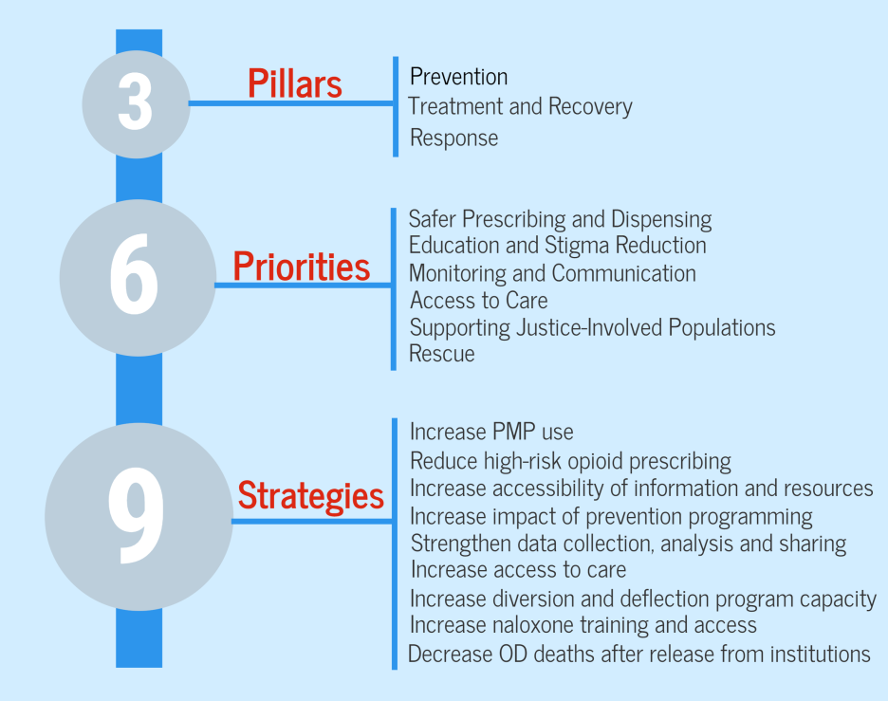
State of Illinois Opioid Action Plan
Notes:
The Plan focuses on efforts that fall into three pillars, six main priorities and nine evidence-based strategies. Briefly, these include:
PREVENTION – preventing the further spread of the opioid crisis through safer prescribing and dispensing (i.e., increase PMP use, reduce high-risk prescribing via provider education and guidelines), education and stigma reduction, and monitoring and communication;
Treatment and Recovery – providing evidence-based treatment and recovery services to Illinois residents with opioid use disorder (OUD) by increasing access to care (i.e., medication-assisted treatment and recovery support services) and supporting justice-involved populations by increasing deflection and diversion programs statewide;
Rescue – averting overdose deaths by increasing the number of first responders and community members who are trained and have access to naloxone, and decrease the number of overdose deaths after an at-risk individual’s immediate release from a correctional or other institutional facility.

Slide 24
Opioid Prevention and Intervention Task Force Goals
Issue a standing order for naloxone to increase its availability and accessibility statewide;
• Compile a comprehensive data report on opioid overdoses and fatalities statewide
• Establish a 24-hour crisis line;
• Create interagency data use agreement to support more effective and efficient public health and public safety response;
• Establish a statewide mechanism for tracking and mapping patterns of opioid use and overdose in real-time to identify and anticipate opportunities for intervention.
Notes:
Task Force is charged with establishing the following policies and programs within the next 90 days:

Slide 25
Prescribing Practices Subcommittee
▪ Making the IL-PMP more user-friendly to increase use and improve work flow
▪ Use the PMP to identify high-risk prescribers and target them for education.
▪ Require education on prescribing guidelines as part of physicians’ CME and licensing.
Notes:
Prescribing Practices Subcommittee focuses on implementing safer prescribing and dispensing
PMP integration in EHRs is a high priority, but there are policy issues and barriers in mandating integration. Additionally, there is a need to integrate the PMP with EHRs beyond hospital systems. Incentives to use the PMP— such as tying it to CMEs and licensing—also are needed.

Slide 26
Update on New Legislation
SB0772
  Effective January 1st, 2018
  Mandates that all prescribers of controlled substances attempt to check the PMP prior to prescribing a controlled substance.
    Excludes prescriptions for oncology, palliative care, and 7-day or less supply provided by hospital emergency department when treating acute, traumatic medical condition
Notes:
Recently there was an AMENDMENT TO SENATE BILL 0772
If passed this bill will mandate that all prescribers of controlled substances (those with a controlled substance license) to attempt to check the PMP prior to prescribing any controlled substance.
Excludes prescriptions for oncology, palliative care, and 7-day or less supply provided by hospital emergency department when treating acute, traumatic medical condition
Attempts should be documented in the patients medical record

Slide 27
Mandated Use
Increased Enrollment
Increased Utilization
Decreased Multiple Provider Episodes
Decreased opioid prescribing
Notes:
As rates of PDMP participation have increased in these states, measures of multiple provider episodes (MPEs, an
indicator of possible inappropriate use of controlled substances) and prescribing of certain drugs have
declined. This suggests that PDMP utilization helps to promote medically warranted prescribing and
dispensing, and can assist in detecting possible controlled substance misuse and diversion.

Slide 28
The PMP can be a powerful tool in combatting the opioid epidemic
  Helps identify and/or refine priorities
  Helps target prevention efforts
  May change prescriber behavior
  Monitor progress and track emerging trends
Notes:
Practitioners working to prevent and/or reduce prescription drug misuse and opioid overdose can use PDMP data in a variety of ways:
Helps identify and/or refine priorities. PMP data can offer a compelling, real-time snapshot of opioid prescribing rates in a state, region, or community. For example, PDMP data may reveal that hydrocodone and oxycodone are the most commonly prescribed opioids as compared to others. Prevention practitioners can use these data to refine their priorities and engage appropriate stakeholders in prevention efforts.
Helps target prevention efforts. For example, prevention practitioners can use PDMP data to pin-point the geographic location of patients that are at risk for opioid misuse (e.g., those that are prescribed excessive quantities and/or are engaged in doctor/pharmacy shopping). By identifying “hot spots,” they can anticipate where they are likely to see higher rates of opioid-related hospitalizations or overdose deaths and direct resources accordingly.
May change prescriber behavior. For example, a growing number of states have begun sharing PDMP data using prescriber “report cards,” which compare practitioners’ prescribing practices to their peers in the same specialty. These reports can alert prescribers about at-risk patients and prompt them to take necessary steps to prevent opioid misuse.
May help us monitor progress and track emerging trends. Reviewing PMP data periodically can tell prescribers, pharmacies, and prevention practitioners about new controlled substances about which they need to be cognizant (e.g., if rates of use are increasing).

Slide 29
Questions?

